Slide 1

Political Violence in Ethiopia
Sri Ramesh, Fall 2020

Slide 2
Key Questions
How do COVID-19 cases overlap with political violence events in Ethiopia?
Where can medical clinics be placed to serve areas of highest humanitarian need?

Slide 3
Political Violence in Ethiopia,
Jan - Oct 2020 (gray) vs. Nov 2020 (red)

Slide 4
Political Violence in Ethiopia,
Nov 2020 (red) vs. All Time (gray)

Slide 5
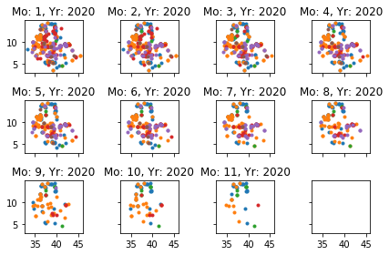
Political Violence in Ethiopia by Month

Slide 6
Hotspot analysis
Where there are hotspots of violence in Ethiopia this year?
What kinds of violence are there hotspots in (e.g. battles, explosions, protests, strategic developments)
Will use kernel density estimation and a Monte Carlo simulation of the K-function to estimate

Slide 7
COVID Cases by District (Adm 1)

